Slide 1
Concerns about the Healthy Streets Operation Center (HSOC)
Coalition on Homelessness Human Rights Workgroup
Local Homeless Coordinating Board Meeting 10/1

Slide 2
Slide from Police Commission Presentation by Commander Lazar
Notes:
Since 2018 The Healthy Street Operationns Center (HSOC) has been the lead on addressing street homelessness across city agenc, as can be here in a slide from Commander Lazar’s presentation on HSOC.
(I include this slide simply to demonstrate what HSOC is in their own words)

Slide 3
Slide from Police Commission Presentation by Commander Lazar
Notes:
It claims its primary goal to be “assisting as many people as possible by connecting them to shelter, services, and housing.

Slide 4
Commitment to Community Engagement
HSOC Memo on “Operational Reccomendations for HSOC Policy Group” June 7, 2018
Obtained thorugh Sunshine Act Request
Notes:
HSOC also states that it has a goal of community engagement, including regular updates to the Local Homeless Coordinating Board and its Community Task Force.

Slide 5
Our Concerns
HSOC is not adequately meeting its primary goal of assisting homeless persons and “meeting the needs of each person in the encampment and assisting them to end their homelessness” (USICH, 2015).
HSOC is led by the SFPD and DPW rather than HSH and DPH
Criminalization of homelessness and human rights violations against those on the streets have increased since its initiation.
Inadequate Services are Inadequately Offered. Navigation Centers have been reformatted from serving homeless people to serving sweeps and the interests of the housed.
HSOC is not meeting its objectives of community engagement.
Decisions about street homelessness have become more opaque from service providers and advocates.
HSOC is disregarding and contradicting proven best practices laid out by the US Interagency Council on Homelessness.
- HSOC’s handling of street homelessness lacks intensive and persistent outreach, low-barrier pathways to services and shelters, access to medical services, and documenting outcomes.
Notes:
We have three concerns that we feel should involve the oversight and recommendations of the Local Coordinating Board. First is that HSOC is not meeting its primary goal of assisting homeless persons, and is in fact contributing to the criminalization of homelessness. Second is that HSOC is not meeting its objectives of community engagement by excluding service providers and advocates by failing to communicate and educate us on what they are actually doing and why, let alone asking our advice and input on how to address street homelessness. And third, is that HSOC is directly contradicting proven best practices laid out by the US Interagency Council on Homelessness.

Slide 6
1.
HSOC is not adequately meeting its primary goal of assisting homeless persons and “meeting the needs of each person in the encampment and assisting them to end their homelessness.”
Notes:
First, HSOC is not adequately meeting its primary goal of assisting homeless persons and “meeting the needs of each person in the encampment and assisting them to end their homelessness.”

Slide 7
HSOC is led by the SFPD and DPW rather than HSH and DPH and leads with enforcement and street cleaning rather than outreach.
Slide from Police Commission Presentation by Commander Lazar
Notes:
Although HSOC claims that the SFPD will be the agency of last resort, in practice they are the lead agency and HSOC relies far more heavily on SFPD officers and DPW workers than DPH outreach workers.

Slide 8
HSOC is led by the SFPD and DPW rather than HSH and DPH and leads with enforcement and street cleaning rather than outreach.
Source: HSOC Public Messaging Appendix B
Notes:
From their own public messaging documents we see that the lead incident commander, is Commander David Lazar from the Police Department who quote “responsible for coordinating efforts of EACH of the agencies for addressing homelessness”

Slide 9
HSOC Encampment Response Presentation
Notes:
HSOC is clear that they would like to respond with HSH and DPH, but they lack the current capacity.

Slide 10
HSOC is led by the SFPD and DPW rather than HSH and DPH and leads with enforcement and street cleaning rather than outreach.
Photograph from San Francisco Chronicle’s on HSOC
Notes:
So instead of a group of trained social workers addressing street homelessness in San Francisco, this is what San Francisco’s Street homelessness operation center looks like.

Slide 11
Notes:
And this is how it looks like on the streets.. No DPH, no Hot Team, No notice, a phalanx of officers preventing the man from rescuing his property at the threat of a misdemeanor arrest, as the officer mentions with 647e, which is being increasingly used by HSOC.

Slide 12
Leading with criminalization if capacity of outreach, shelter, or assistance is lacking.
June 15, 2018 email from Jeff Kositsky to Muhammad Nuru, Chief Scott, Jason Elliott, and Naomi Kelly on HSOC Process.
Obtained through Sunshine act Request.
Notes:
In this Email from Jeff Kositsky on June 15 to Muhammed Nuru, Chief Scott, Jason Elliott, Naomi Kelly we see that when services and shelter is lacking that SFPD and Public Works should proceed to clear encampments. This is in direct contradiction to the Interagency Council Guidelines and possibly the 9th Circuit Court of Appeals recent ruling that policing and property clearance without adequate time of notice, and coordinated resolutions with offers of services is a form of cruel and unusual punishment. Perhaps more disturbing is that the city’s Department on Homelessness envisions a city where 3,000 people who have no access to shelter should be forced to sleep on the cold concrete rather than protect themselves with some form of tent or structure from the elements.

Slide 13
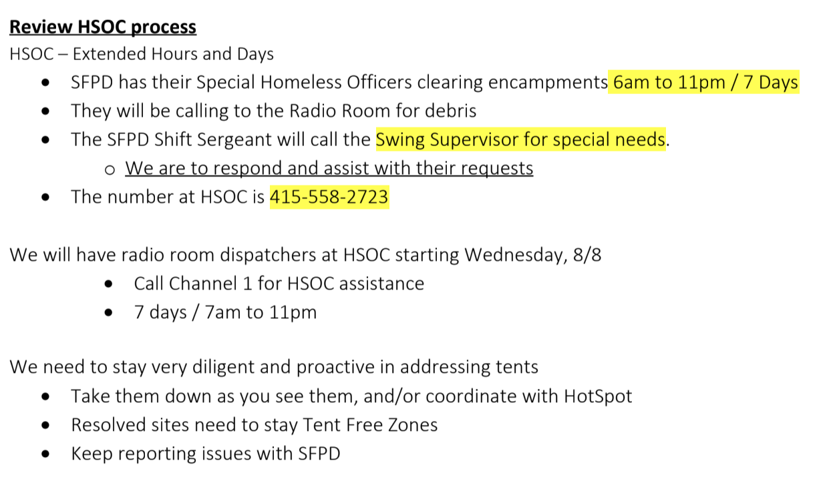
Email from Peter Lau, DPW, on HSOC Process to DPW workers (Aug 8, 2018). Obtained through Sunshine Act Request
Note: No mention of HSH, DPH, services, adequate time and notice, or housing/shelter plan for homeless
Notes:
From another email from DPW on the overview of the HSOC Process we see absolutely no mention of HSH or DPH, it is rather a process that except in exceptional circumstances is managed by DPW and SFPD.

Slide 14
Notes:
In short, this is what the SFPD and in turn HSOC envision as “offering services” in their own words as seen in this twitter post by SFPD’s Tenderloin.

Slide 15
Inadequate Services
are Inadequately Offered
The primary shelter offered is extremely temporary, often 1-7 days. Most navigation center beds now have time limit of 30 days. All shelter offered to those on the streets is at the expense of those on the shelter waitlist who wait an average of 4-6 weeks for a 90 day bed and the 100+ people who typically are denied a shelter bed and sleep in chairs nightly.
Most shelter offered require people to abandon their pets and property: Surrendering the survival gear necessary to exist on the streets that they will most likely be returning to.
Those suffering from mental health problems or drug addiction could have their conditions exacerbated by residing in congregate settings, even in navigation centers as shown in the city’s own reports.
Success rate is very low. In the April camp resolutions in the Mission an HSH memo stated only 8 people accepted the 7-day shelter offer among 100 tents, which comprised at least 150 people. about 5%. While navigation center acceptance is much higher (65%), the vast majority being asked to move by DPW and SFPD are not offered this (HSH response to Coalition Analysis May, 2018).
Notes:
Finally, when services are actually offered they are entirely inadequate. HSH and I’m sure we will hear Sam Dodge today discuss the services that are being offered, and we are happy to see more navigation centers and more street outreach, but at the same time the city has hired far more officers and DPW workers to address street homelessness. The increases in services is not enough, nor is it an excuse to increase criminalization and camp clearances by DPW and the SFPD.
Here are just a few points about how the main services offered to those on the streets are inadequate:
The primary shelter offered is extremely temporary, often 1-7 days. Most navigation center beds now have time limit of 30 days. All shelter offered to those on the streets is at the expense of those on the shelter waitlist who wait an average of 4-6 weeks for a 90 day bed and the 100+ people who typically are denied a shelter bed and sleep in chairs nightly.
Most shelter offered require people to abandon their pets and property: Surrendering the survival gear necessary to exist on the streets that they will most likely be returning to.
Those suffering from mental health problems or drug addiction could have their conditions exacerbated by residing in congregate settings, even in navigation centers as shown in the city’s own reports.
Success rate is very low. In the April camp resolutions in the Mission an HSH memo stated only 8 people accepted the 7-day shelter offer among 100 tents, which comprised at least 150 people. about 5%. While navigation center acceptance is much higher (65%), the vast majority being asked to move by DPW and SFPD are not offered this (HSH response to Coalition Analysis May, 2018).

Slide 16
Criminalization of homelessness and human rights violations against those on the streets have increased since HSOC’s initiation.
Notes:
Instead, Criminalization of homelessness and human rights violations against those on the streets have increased since HSOC’s initiation. We have current requests for data on citations, in particular the city’s use of 647e charging homeless persons with misdemeanors for illegal lodgings as we heard referred to in the video and in the recent coverage of artist Ronnie Goodman’s arrest. This is a charge that was not used at all in 2017 according to a representative at the public defender’s office. We will share this data with the Board as soon as we obtain it. Or perhaps we can ask Mr. Dodge here since a core goal of HSOC is to document and collect better data on the outcomes of the operation center of which enforcement plays a leading a role. However, from our outreach we have been hearing since March from those on the streets that the sweeps have been relentless leading to more property confiscation and move-along orders, which multiple social scientific studies have now shown lead to prolonged homelessness, barriers to obtain services and housing, negative health outcomes, and increased inequality.

Slide 17
2.
HSOC is not meeting its objectives of community engagement.
Notes:
Our second concern is that HSOC is not meeting its objectives of community engagement.

Slide 18
HSOC is not meeting its objectives of community engagement.
Police Commission requested SFPD to work with Coalition and community partners on reforming 311 and 911 triage, no effort has been made.
An SFPD community homeless advisory board was created in September of 2017. HSOC opened without any discussion or even mention to the advisory board. 30% of the advisory board meetings have been cancelled by the SFPD, and another 10% have been rescheduled by the SFPD without community input.
Notes:
The Police Commission requested SFPD to work with Coalition and community partners on reforming 311 and 911 triage in the spring of 2017, nearly two years later no effort on this task has been made.
An SFPD community homeless advisory board was created in September of 2017. However, there was no mention let alone a discussion with the advisory board about HSOC. Furthermore, 30% of the advisory board meetings have been cancelled by the SFPD, and another 10% have been rescheduled by the SFPD without community input.

Slide 19
Service providers have played no meaningful role in the development of this new policy approach, which has the primary stated aim of assisting those on the streets.
Notes:
Service providers have played no meaningful role in the development of this new policy approach, which has the primary stated aim of assisting those on the streets. Instead, providers have had their efforts of assistance undermined by HSOC which is creating more barriers to accessing services as we all remember when they cleared encampments outside of Glide as people were trying to get a meal.

Slide 20
Notes:
Bonus Slide. Kelley could refer to this email in requesting a monthly report to the LHCB.

Slide 21
3.
HSOC is contradicting Federal best practice guidelines to resolving encampments
Notes:
Our third concern is that HSOC is contradicting HSOC is contradicting Federal best practice guidelines to resolving encampments

Slide 22
Effective Strategies and Approaches for Encampment Resolutions
1. Preparation and Adequate Time for Planning and Implementation for a camp resolution
2. Collaboration across Sectors and Systems, including service providers and community organizations.
3. Performance of intensive and Persistent Outreach and Engagement to connect people with coordinated assessment systems, resources, and housing options
From USICH guidelines on resolving encampments, August, 2015.
Notes:
To just take three of the key guidelines.
1. Preparation and Adequate Time for Planning and Implementation for a camp resolution
2. Collaboration across Sectors and Systems, including service providers and community organizations.
3. Performance of intensive and Persistent Outreach and Engagement to connect people with coordinated assessment systems, resources, and housing options.
As you’ve seen in our presentation, none of these are being followed by HSOC.

Slide 23
Recommendations
Follow federal guidelines to:
Work with community partners and service providers with implementation of HSOC’s homelessness policies.
Shift command and resources so that HSH and DPH are in leadership positions, are first responders in all encampment removals, and have more staff than SFPD and DPW.
Provide adequate time and preparation for every camp removal, not only the few classified as “resolutions” (>5% of removals).
Follow DPW and SFPD protocols of handling property of unhoused.
Follow 9th Circuit Court ruling that nobody should be cited or arrested unless adequate and appropriate shelter or housing is available without denying others who are trying to access these resources.
Notes:
So we’re not against more coordinated responses to street homelessness. But we’d like to see some recommendations implemented to help HSOC at least meet the minimal federal guidelines.
Follow federal guidelines to:
Work with community partners and service providers with implementation of HSOC’s homelessness policies.
Shift command and resources so that HSH and DPH are in leadership positions, are first responders in all encampment removals, and have more staff than SFPD and DPW.
Provide adequate time and preparation for every camp removal, not only the few classified as “resolutions” which has got to be less than 5% of HSOC’s operation if not much less.
Follow DPW and SFPD protocols of handling property of unhoused. We hear constantly of people not being able to retrieve property taken by DPW that many believe according to DPW’s own official policy should never have been taken in the first place.
Follow 9th Circuit Court ruling that nobody should be cited or arrested unless adequate and appropriate shelter or housing is available without denying others who are trying to access these resources.

Slide 24
Thank You

